Slide 1
Core Curriculum Redesign @MCLA
AMCOA Lightning Talk
March 10, 2021
Erin Milne & Chris MacDonald-Dennis

Slide 2
Lightning Talk Overview
A Bit of Context
Developing SLOs
New Focus: Integrative Learning
Infusing DEI Initiatives
Where Are We Now?

Slide 3
Context
How did we get here?

Slide 4
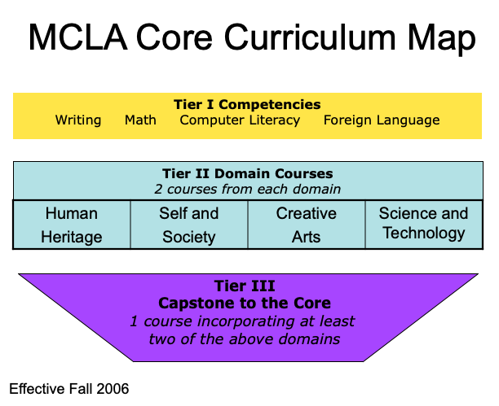

Slide 5
Key Issues with the "Old Core"
Difficult to staff the original plan for interdisciplinary Core courses.
Lack of oversight and support structures.
No shared understanding of the purpose of the Core Curriculum.

Slide 6
Redesigning MCLA's Core Curriculum
2014
Initial conversations around Core revision
Summer 2016
Summer 2018
AAC&U Institute on Integrative Learning & Signature Work
AAC&U Institute on General Education and Assessment
Spring 2020
Final structure of the revised Core Curriculum pass through governance
The new Core Curriculum goes live!
Fall 2021

Slide 7
Student Learning Outcomes & Integrative Learning
Aligning priorities across the Core

Slide 8
New Student Learning Outcomes
Goal 1: MCLA’s graduates are effective communicators who utilize multiple forms of expression to participate in our global community.
Goal 2: MCLA’s graduates engage in analytical inquiry to address complex problems.
Goal 3: MCLA’s graduates are active, engaged, and ethical individuals.
Notes:
Goal 1: MCLA’s graduates are effective communicators who utilize multiple forms of expression to participate in our global community.
Students choose appropriate form(s) of expression to effectively communicate with audiences from different backgrounds and perspectives.
Students defend their positions making reference to diverse perspectives.
Goal 2: MCLA’s graduates engage in analytical inquiry to address complex problems.
Students synthesize contrasting/conflicting information and perspectives to accurately understand problems.
Students apply contextually appropriate methods and approaches when analyzing and solving problems.
Students make connections across disciplines and personal experience when solving problems.
Goal 3: MCLA’s graduates are active, engaged, and ethical individuals.
Students engage in meaningful self-reflection and evaluation of their own learning and contributions.

Slide 9

What is Integrative Learning?
An approach to teaching that supports the development of skills enabling students to make connections among concepts and experiences, so they can apply information and skills to novel and complex contexts.

Slide 10
Why an Integrative Core Curriculum?
A Core Curriculum founded on principles of integrative learning prepares students to make connections across their curricular, co-curricular, and community experiences.
Students who can integrate their learning recognize and evaluate connections among diverse concepts, contexts, and lived experiences.
Students who can integrate have the skills to create, innovate, and collaborate successfully in a diverse world.

Slide 11
Core Learning Outcome | Integrative Learning Outcome | Capstone Level | Content Level | Foundational Level | Incoming Level
MCLA’s graduates are effective communicators who utilize multiple forms of expression to participate in our global community. | Students choose appropriate form(s) of expression to effectively communicate with audiences from different backgrounds and perspectives. | Chooses a format, language, or visual representation in ways that enhance meaning, making clear the interdependence of language, thought, and expression. Student is able to skillfully negotiate a shared understanding across diverse audiences. | Chooses a format, language, or visual representation to explicitly connect content and form, demonstrating awareness of purpose and audience. | Chooses a format, language, or visual representation that connects in a basic way what is being communicated (content) with how it is said (form). | Produces an essay, a poster, a video, a PowerPoint presentation, etc. in an appropriate form.
 | Students defend their positions making reference to diverse perspectives. | Demonstrates skillful use of high quality, credible, relevant sources from diverse perspectives to appropriately defend their positions. | Demonstrates consistent use of credible, relevant sources to defend their positions. | Demonstrates an attempt to use credible and/or relevant sources to support their positions. | Demonstrates an attempt to use sources to support their positions.

Slide 12
Core Learning Outcome | Integrative Learning Outcome | Capstone Level | Content Level | Foundational Level | Incoming Level
MCLA’s graduates engage in analytical inquiry to address complex problems. | Students synthesize contrasting/ conflicting information and perspectives to accurately understand problems. | Synthesizes in-depth information from relevant sources representing various points of view/ approaches to construct a clear and insightful problem statement with evidence of all relevant contextual factors. | Presents in-depth information from relevant sources representing various points of view/approaches to construct a problem statement with evidence of most relevant contextual factors, and problem statement is adequately detailed. | Presents information from relevant sources representing limited points of view/approaches to demonstrate the ability to construct a problem statement with evidence of most relevant contextual factors, but problem statement is superficial. | Presents information from sources representing limited points of view/approaches in identifying a problem statement or related contextual factors.
 | Students apply contextually-appropriate methods and approaches when analyzing and solving problems. | Identifies and applies the most appropriate approach(es) for solving the problem that apply within a specific context. | Identifies multiple approaches for solving the problem, only some of which apply within a specific context. | Identifies an approach for solving the problem that applies within a specific context. | Identifies one or more solutions to a problem without regard to a specific context.
 | Students make connections across disciplines and personal experience when solving problems. | Independently creates wholes out of multiple parts (synthesizes) or draws conclusions by combining examples, facts, or theories from more than one field of study or perspective. | Independently connects examples, facts, or theories from more than one field of study or perspective. | When prompted, connects examples, facts, or theories from more than one field of study or perspective. | When prompted, presents examples, facts, or theories from more than one field of study or perspective.

Slide 13
Core Learning Outcome | Integrative Learning Outcome | Capstone Level | Content Level | Foundational Level | Incoming Level
MCLA’s graduates are active, engaged, and ethical individuals. | Students engage in meaningful self-reflection and evaluation of their own learning and contributions. | Envisions a future self that builds on past experiences across multiple and diverse contexts (e.g., works with ambiguity and risk, deals with frustration, considers ethical frameworks). Makes contributions to the learning community based on evaluation of strengths. | Evaluates changes in own learning process over time. Identifies key recurring factors in their own effectiveness (e.g., works with ambiguity and risk, deals with frustration, considers ethical frameworks) and ways to address these factors. | Articulates strengths and challenges within specific performances or events. Begins to identify ways to increase effectiveness in future contexts. | Describes own performances with general descriptors of success and failure.

Slide 14
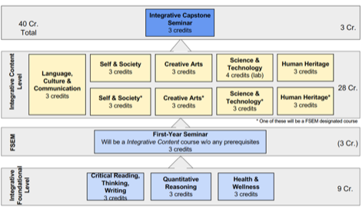
Revised Core Structure
Developmental Opportunities for Integrative Learning
Fully Aligned Student Learning Outcomes
This Core Structure Map is also found in BOT retreat handout folder.

Slide 15
New Elements
New Courses
  Health & Wellness
  First-Year Seminar
  Language, Culture & Communication
  Integrative Capstone
Infused Throughout
  Civic Learning/Engagement
  Diversity, Equity, and Inclusion
  High Impact Practices

Slide 16
Diversity, Equity, and Inclusion
Embedding initiatives at all levels.

Slide 17
DEI in MCLA's Core Curriculum
DEI is an essential aspect of the broader Integrative Learning Framework
  Infused throughout the SLOs at all levels, in all domains
Partnership with the Center for Teaching & Learning to support the development of Core courses
  Capstone Development Workshop
    Example: Capstone Course in Computer Science
  First Year Seminar Development Workshop
  Anti-Racist Pedagogies Faculty Learning Community
Designated Seat for Chief Diversity Officer on the Core Curriculum Steering Committee

Slide 18
Where are we now?
The work continues.

Slide 19
Where Are We Now?
Initial Course Review by Core Curriculum Steering Committee
Ongoing Review and Approval Process
Assessment & Professional Development
Communications Strategy

